Slide 1












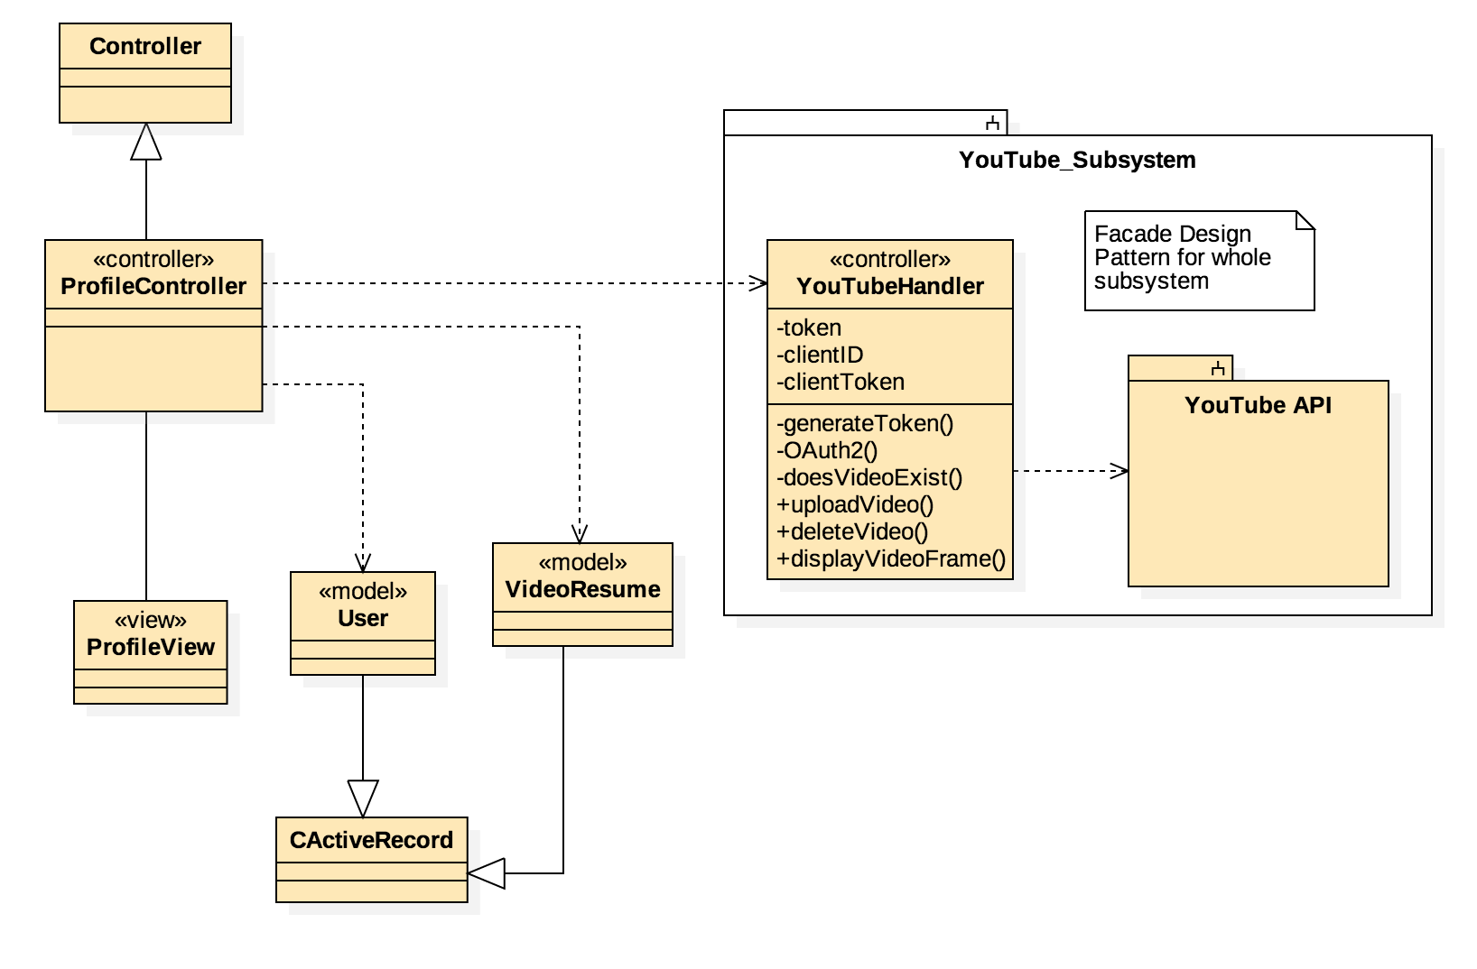

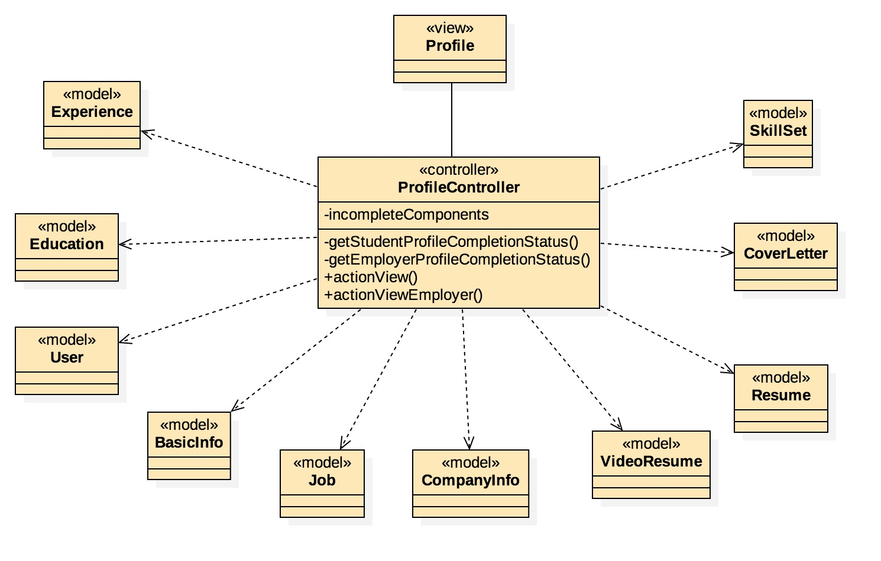

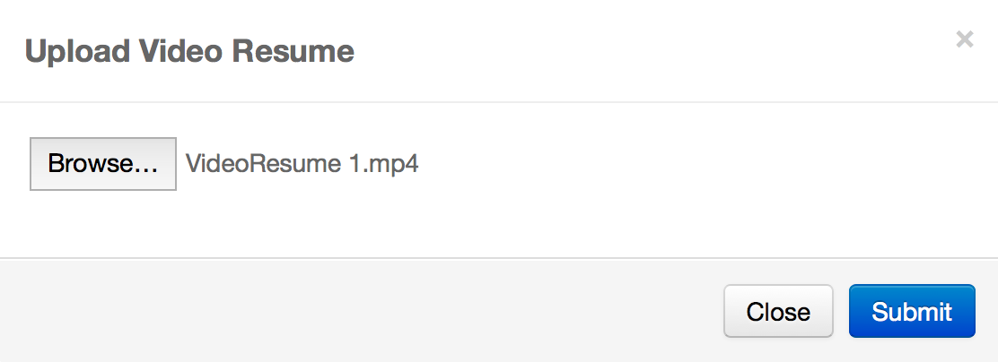
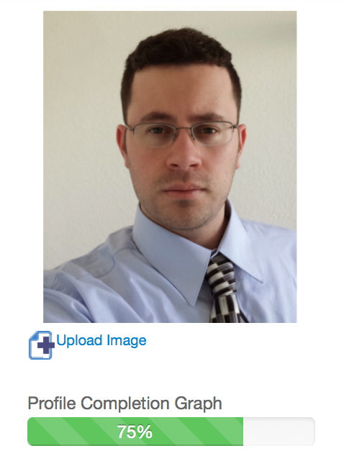
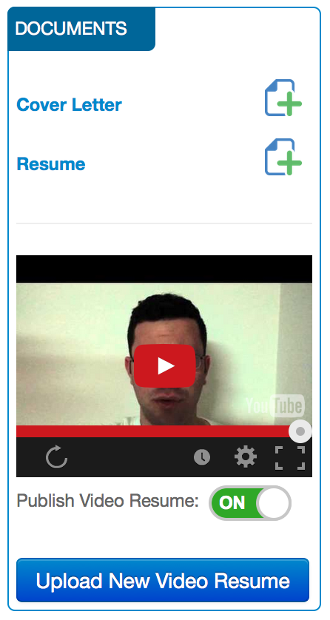
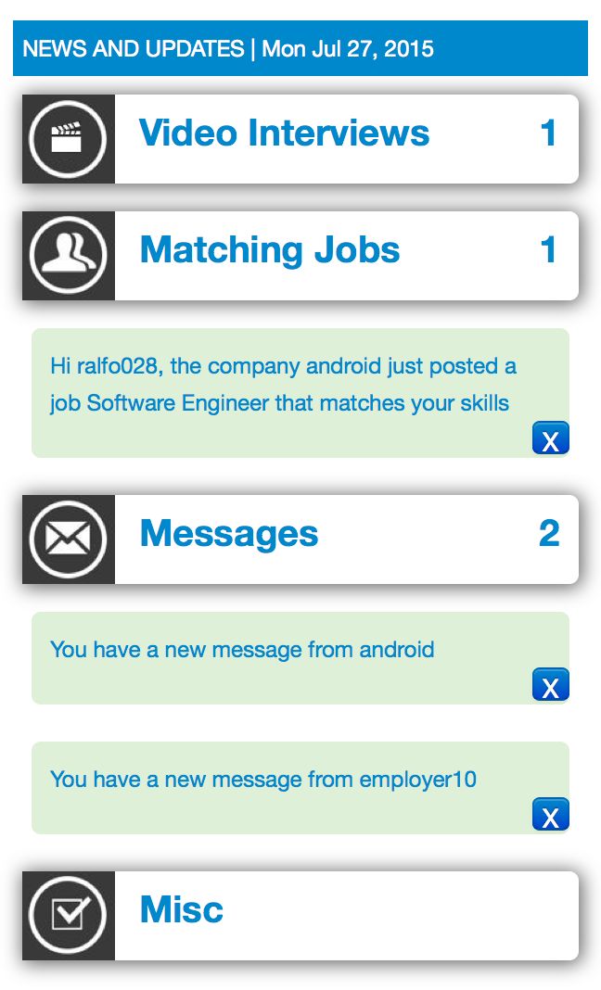
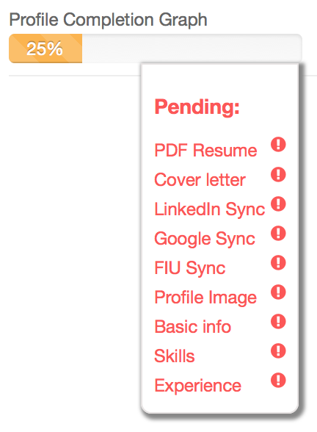
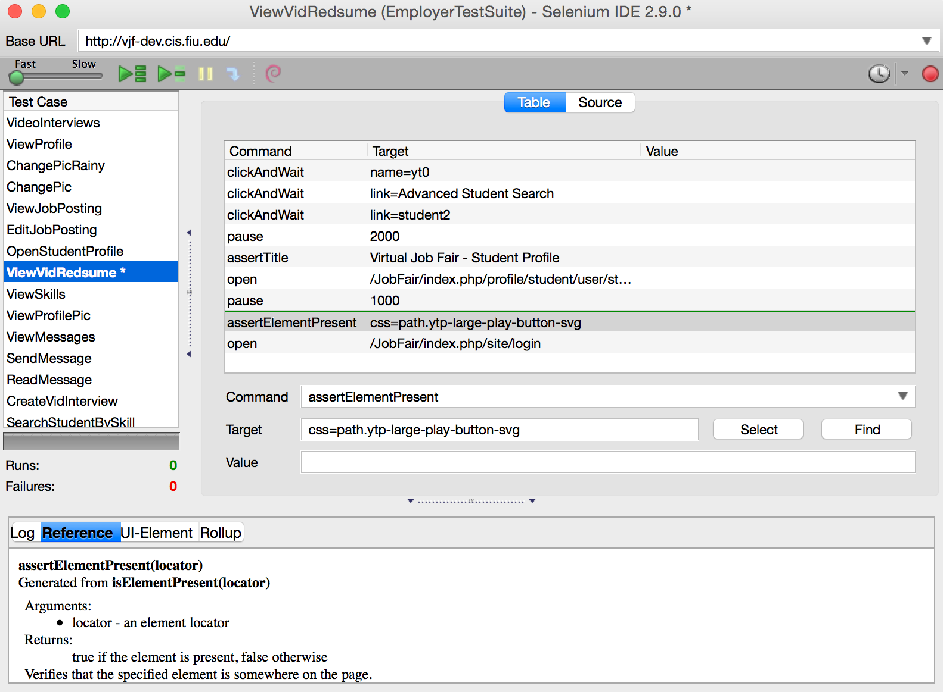

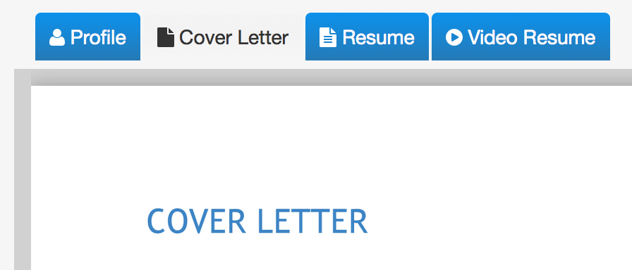

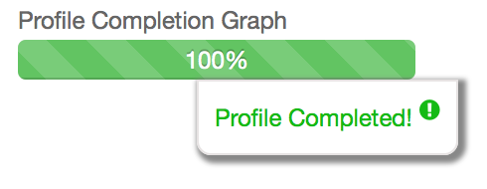
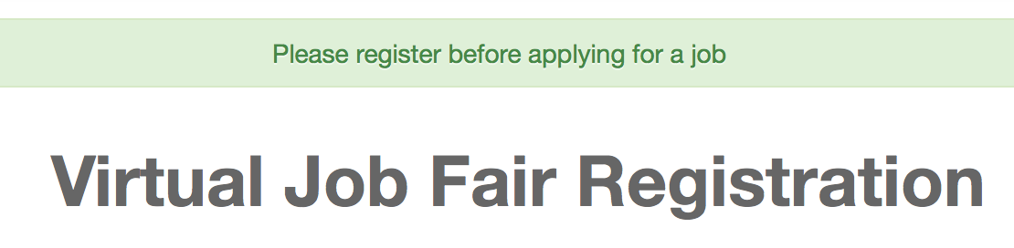
School of Computing & Information Sciences
Senior Project, 2015, Summer
Virtual Job Fair v6.0
Student: Rene Alfonso, Florida International University
Mentor: Masoud Sadjadi, FIU
Instructor: Masoud Sadjadi, Florida International University
V6.0
Problem
Current System
Requirements
The Virtual Job Fair system is an efficient way to make a connection between job-seeking students and employers. It facilities the hiring process for both parties involved, and provides a simple and efficient solution for our technologically driven job market. Employers are unable to tap local talent at universities or job fairs due to geographical barriers. These employers don’t have the economic or logistical capabilities to seek for talent in multiple locations. Simultaneously, students don’t have the time or resources to meet potential employers in person. Most students are new to the job market before and after graduation; they are unable to display their skills, experience, and talents via emails. Thus, VJF aims to solve these issues.
The current version of the system was version 5.0. and although it had many good features it still required more development.
Video resumes were stored on the server. It was brought to our attention, by product owner, Fernando Figueredo, that it was of paramount importance to have this feature migrated to YouTube so that server space could be saved.
There were multiple bugs that needed to be fixed before the product could be released. The guest account had access to too many features which lead to security concerns. Students could type in the URL such as ‘/JobFair/index.php/home/employerhome/’ and would then be able to behave as an employer; being able to post jobs, etc. None of the notifications were working correctly. You could upload PDF resumes; however, there were multiple bugs with that. A crucial one was that when a new PDF resume was uploaded the system kept the old resume, without any reference to it, wasting space. The system did not allow for multiple admins due to a bug that wouldn’t allow admins to have any other username but admin.
Upload Video Resumes to YouTube
Allow students to upload Video Resumes.
Store the videos on YouTube.
No YouTube authentication by the student.
The video should not be public.
Student should be able to publish or unpublished a video.
Employers can see the video resumes.
Profile Completion Graph
Create graphical representation of how complete a profile is.
Create the logic that will determine how complete the profile is.
Display the graph to the user.
Display missing components on mouse over.
Increase Guest Account Restrictions
Allow access as guest.
Allow the guest to browse the website.
Limit abilities.
Redirect to registration when using high level feature.
Fix Multiple Bugs
Identify bugs.
Create user stories for bugs.
Fix bugs.
Have website ready for production mode.
System Design
Object Design
Implementation
The original implementation of Virtual Job Fair was developed using the Model View Controller (MVC) software architectural pattern in the Yii Framework. Thus, our team continued to follow the same paradigm in order to maintain a rich, reusable, and well structure software. The benefits of MVC in regards to our software are that it separates logic controllers, models, and graphical user interfaces from each other, so that developers can easily change each part of the system without affecting the others.
YouTube Subsystem
Virtual Job Fair v6.0 was developed using the Scrum software developing methodology. This new version builds up on the previous versions. User stories were created based on specifications by the product owners and the mentor. The user stories served as the specification guidelines of what would be developed. Different user stories required different software engineering approaches. Some of the most interesting approaches used were:
YouTube Subsystem
Design patterns are the best way to solve recurring problems that already have clear solutions which can be reapplied to our needs. Thus, to avoid having many points of entry into the YouTube subsystem I added a Facade design pattern. The YouTubeHandler controller class realizes a Facade design pattern. It was created to facilitate access to the many YouTube API calls via a single point of entry. That is, a single access point into the subsystem. This simplified the amount of dependencies between objects by encapsulating most of the functionality. The Facade keeps a reference to each object that will be called inside the API. It has made the YouTube API easier to use, understand, and test due to its convenient functions for common tasks. Other controllers need not care how the logic happens, they only need but call one function in the Facade and wait for the desired results.
Guest Account
To restrict access to the guest account I relied on the controller rules that can be set using the Yii framework API calls. That is a feature can simply be restricted by creating rules for the functions inside the controller of that feature.
Over All
JavaScript and jQuery were used on the front-end for validation, and combined with HTML5 and Bootstrap for the GUI. The back-end was developed with the Yii framework and PHP. The automated regression test scripts were written in HTML5, CSS3 and JavaScript on Selenium.
1-HTTP Request
Yii Router
7-HTML
2-Action
Profile Completion Graph
View
5-Invoke
Controller
3-Call
Model
6-HTML
4-Send Content
Verification
Screenshots
Summary
The system was tested throughout the whole software development process. At first we created test cases for the Admin, Employer, and Student features. We did this so that we could identify all the bugs in the current system and so that we could fix them. We then proceeded to run our automatic regression tests, with Selenium IDE 2.9, every time we fixed a bug or when a new feature was added to the system; so that we could guarantee the correct behaviors of the system.
The Virtual Job Fair project was an amazing experience for me. I learned valuable lessons and skills that will surely aid me as Software Engineer.
After five Sprints of Scrum Development, 484 hours of work, we were able to fix 53 bugs, create 77 automatic system test cases, and implement 10 new features.
Thanks to this project I learned about Web Development for the first time. I enhanced my knowledge of MySQL. I learned new programming languages: PHP, JavaScript and HMTL.
Ultimately I am very proud of the work I accomplished and that I was able to contribute to the development of this awesome project to showcase my skills.
Acknowledgement
The material presented in this poster is based upon the work supported by Masoud Sadjadi.
I am thankful for the help that I received from the professor, my teammate Yanniel Malagon, and the support of my family.

